Slide 1
Twitter Political Compass Machine
Ming Lun Wu

Slide 2
Background

Slide 3
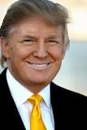
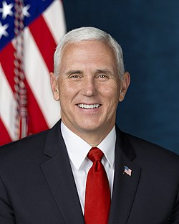
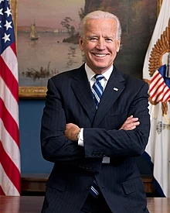
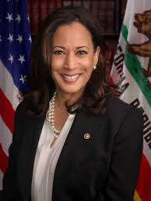
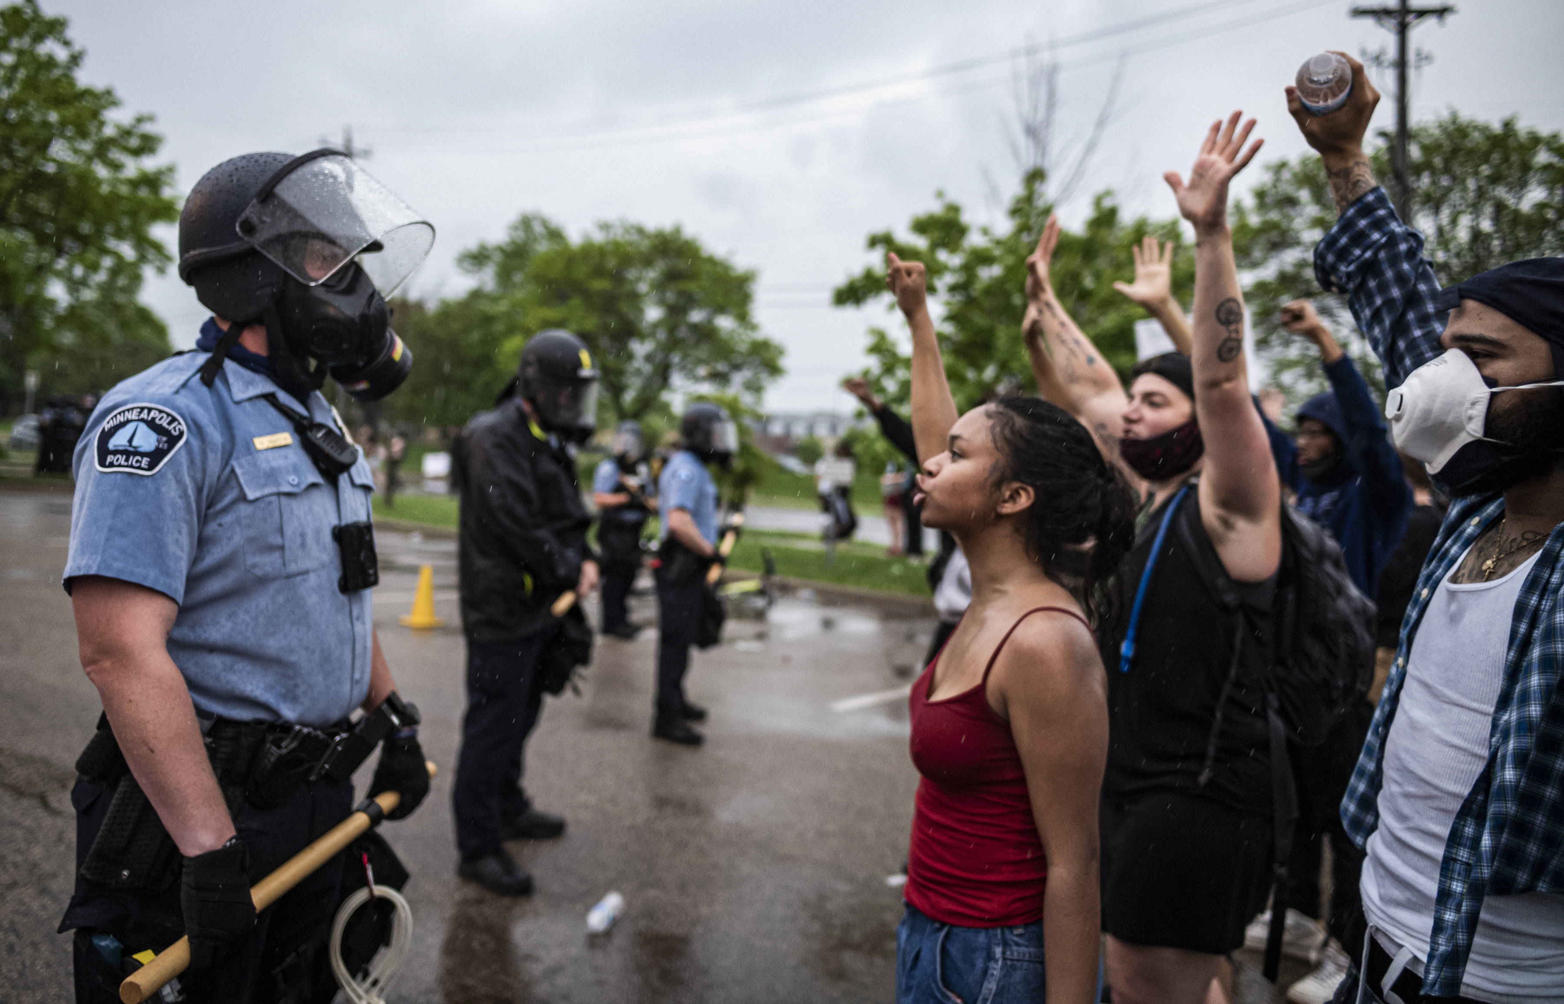
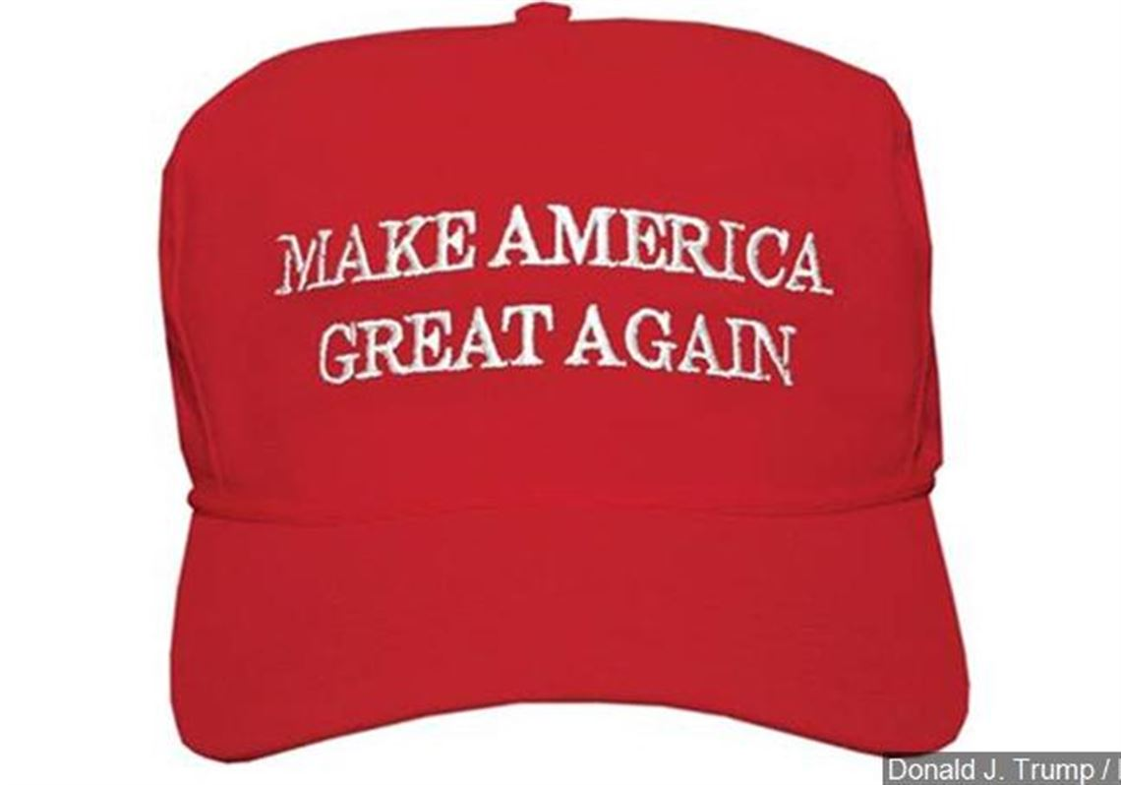
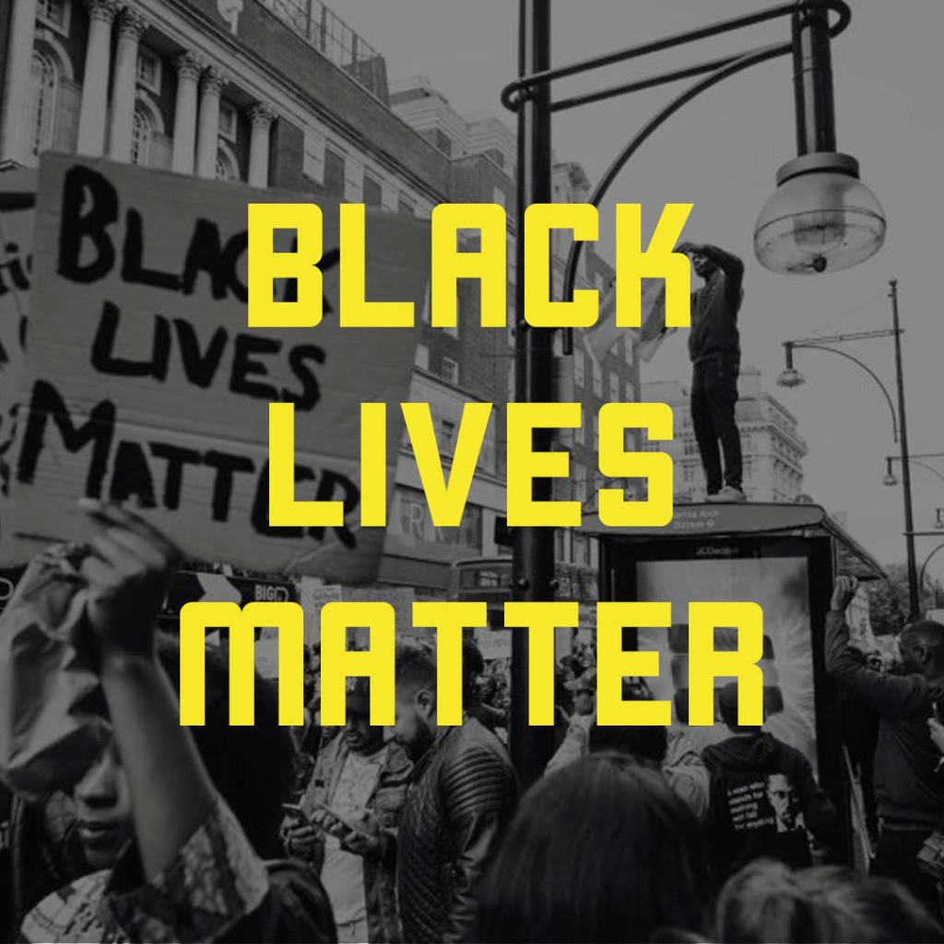
Polarizing Political Stands
Republicans
Democrats

Slide 4
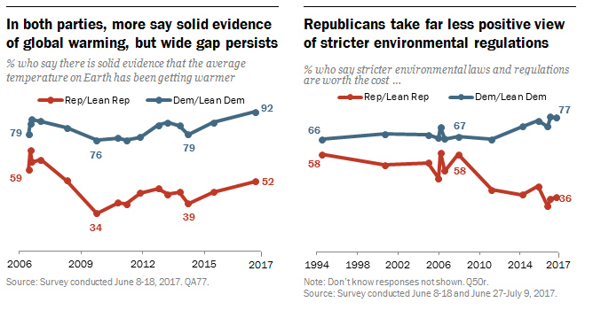
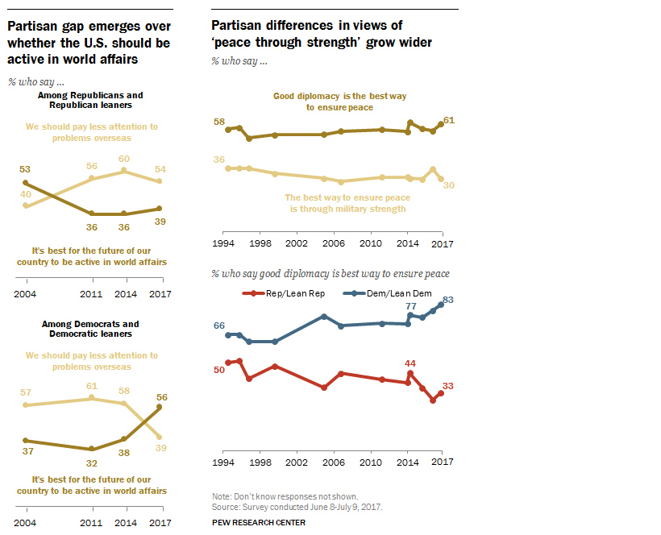
Americans are more divided than Ever
we have never been this divided in opinion/politic as a nation
Source: https://www.visualcapitalist.com/charts-americas-political-divide-1994-2017/

Slide 5
Problem Statement /Motivations

Slide 6
Problem Statement
With social media being the a part of political communication system
Can we based on their social media accounts (Twitter)
Identify a politicians affiliation?
Can we quantify where in the political spectrum do they lie?
Can we quantify intra-party dissonance?

Slide 7


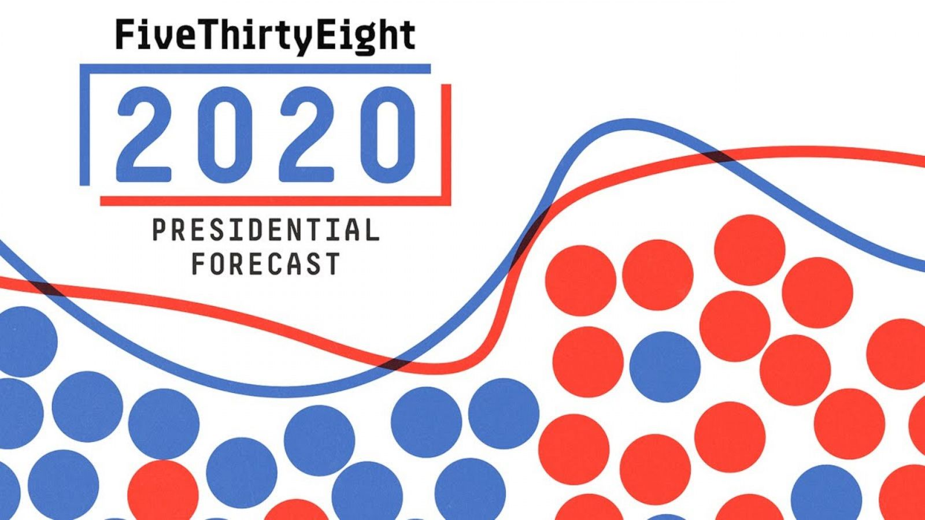
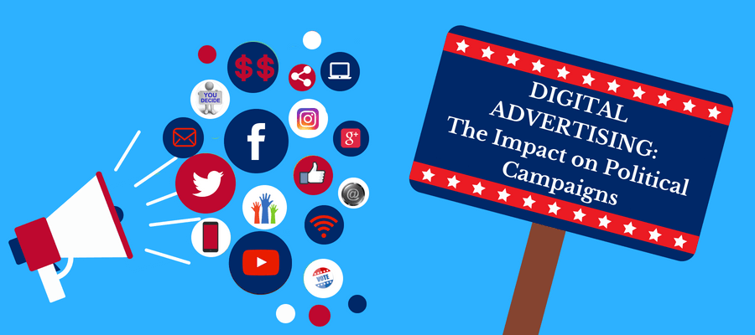
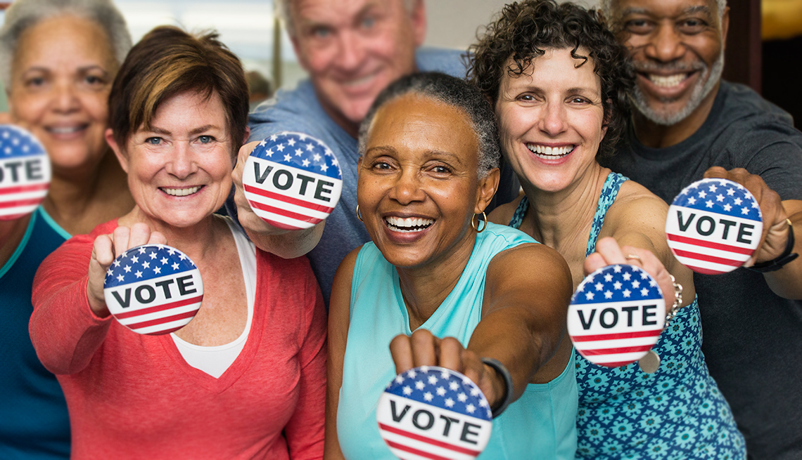
Who cares about this?
Large social media corporation
Forecast Website
Campaign Manager
You the voters

Slide 8
Data
Tweets
All the Senator in US (Include President/VP and nominee)
09-05-2020 to 09-12-2020

Slide 9
Exploratory Data Analysis Features Engineering

Slide 10
Readability Score
Raw Tweets
Would different party wants to appeal to people with different education level base on their language?
3 Types variation of readability were derived
Automated Readability Index (ARI)
Dale Chall Readability (DCR)
Text Standard (TS) - An aggregation of all methods in the package (This will be used as a Feature)
Remove Retweets + Hyperlink
Readability Score

Slide 11
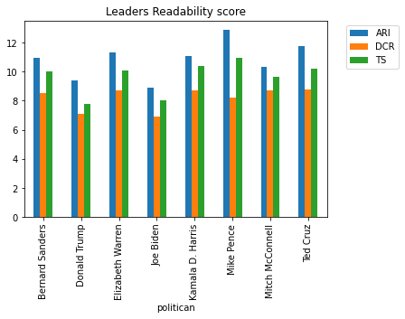
Readability Score of Leaders
Raw Tweets
Remove Retweets + Hyperlink
Readability Score
Takeaway:
Both Presidential Candidate have lowest readability score in general

Slide 12
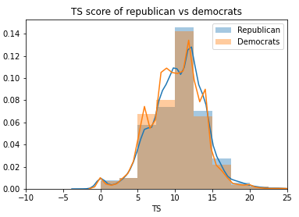
Readability Score
Raw Tweets
Remove Retweets + Hyperlink
Takeaway:
The different of readability score between the Parties score is very subtle. Not much can be drawn from this
Readability Score

Slide 13
Sentiment Score
Raw Tweets
Evaluate positive or negative sentiment towards a particular subject.
Example: Make America Great Again (Something probably Trump would say)
VADER (Valence Aware Dictionary for Sentiment Reasoning)
positive sentiment : (compound score >= 0.05)
neutral sentiment : (compound score > -0.05) and (compound score < 0.05)
negative sentiment : (compound score <= -0.05)
Remove Retweets + Hyperlink
Sentiment Score

Slide 14
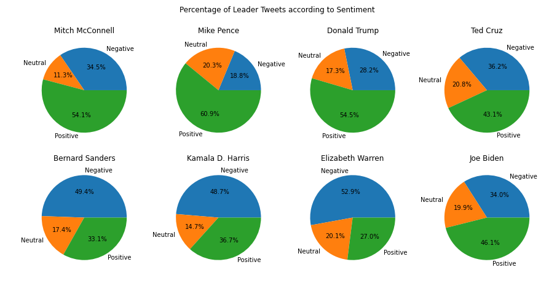
Sentiment Score of Leaders
Raw Tweets
Remove Retweets + Hyperlink
Sentiment Score
Takeaway:
The Republicans generally have tweets with more positive sentiment, where Democrats have more negative sentiment tweets

Slide 15
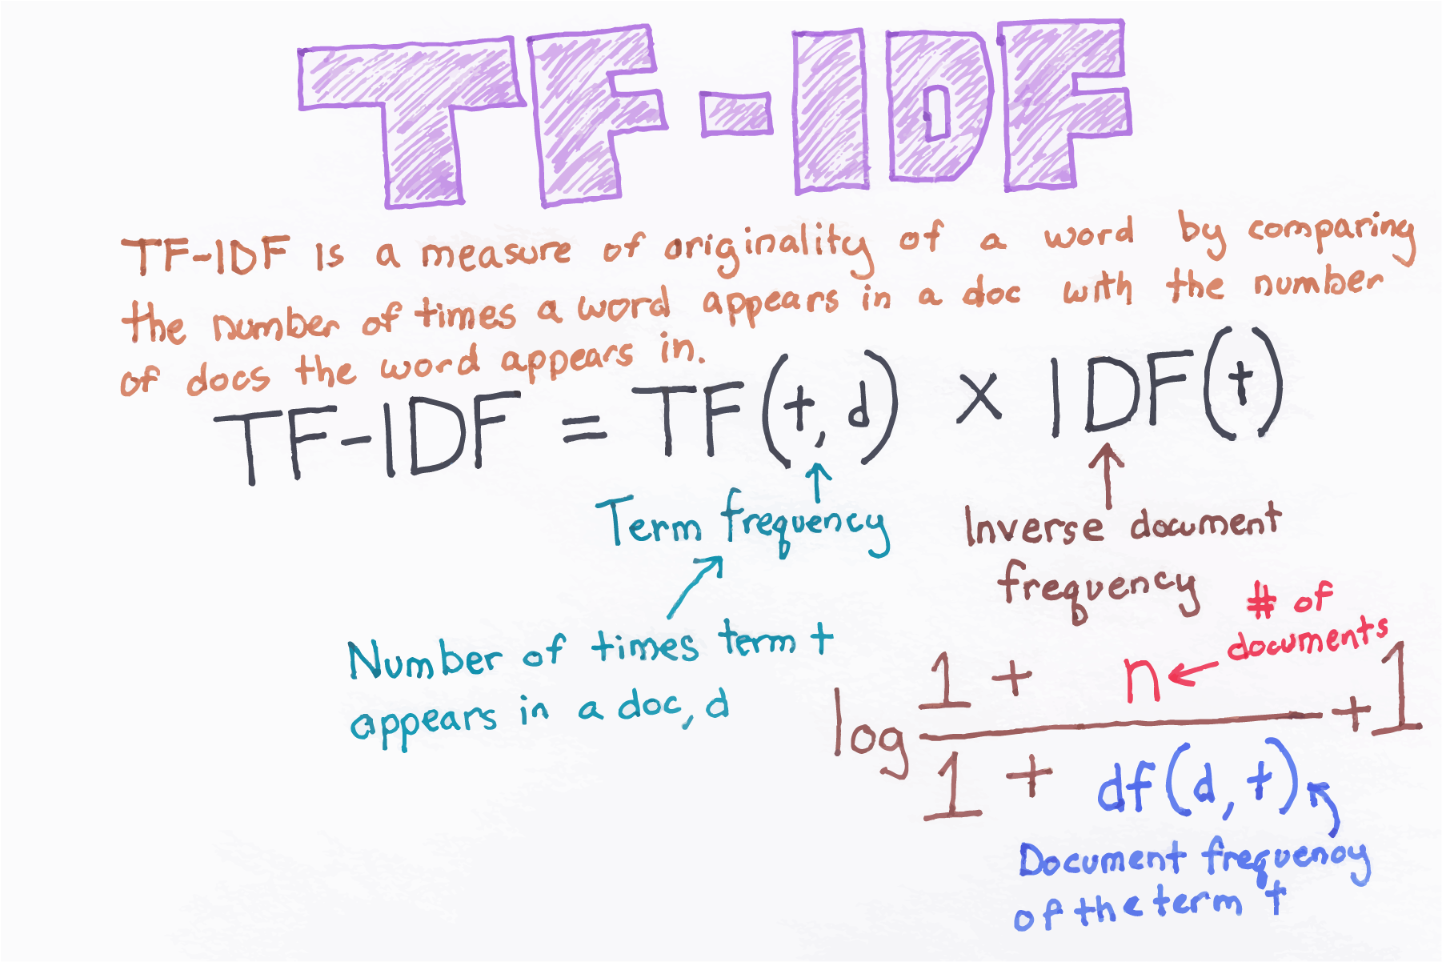
TF-IDF
Raw Tweets
Remove Stop Words
Term Frequency Inverse Document Frequency
Remove Retweets + Hyperlink
Lemming/Stemming
Tokenization
Making a Corpus
Lower the cases
TF – IDF Vectors
Make two for corpus, one for republicans leaders one for democrats leaders

Slide 16
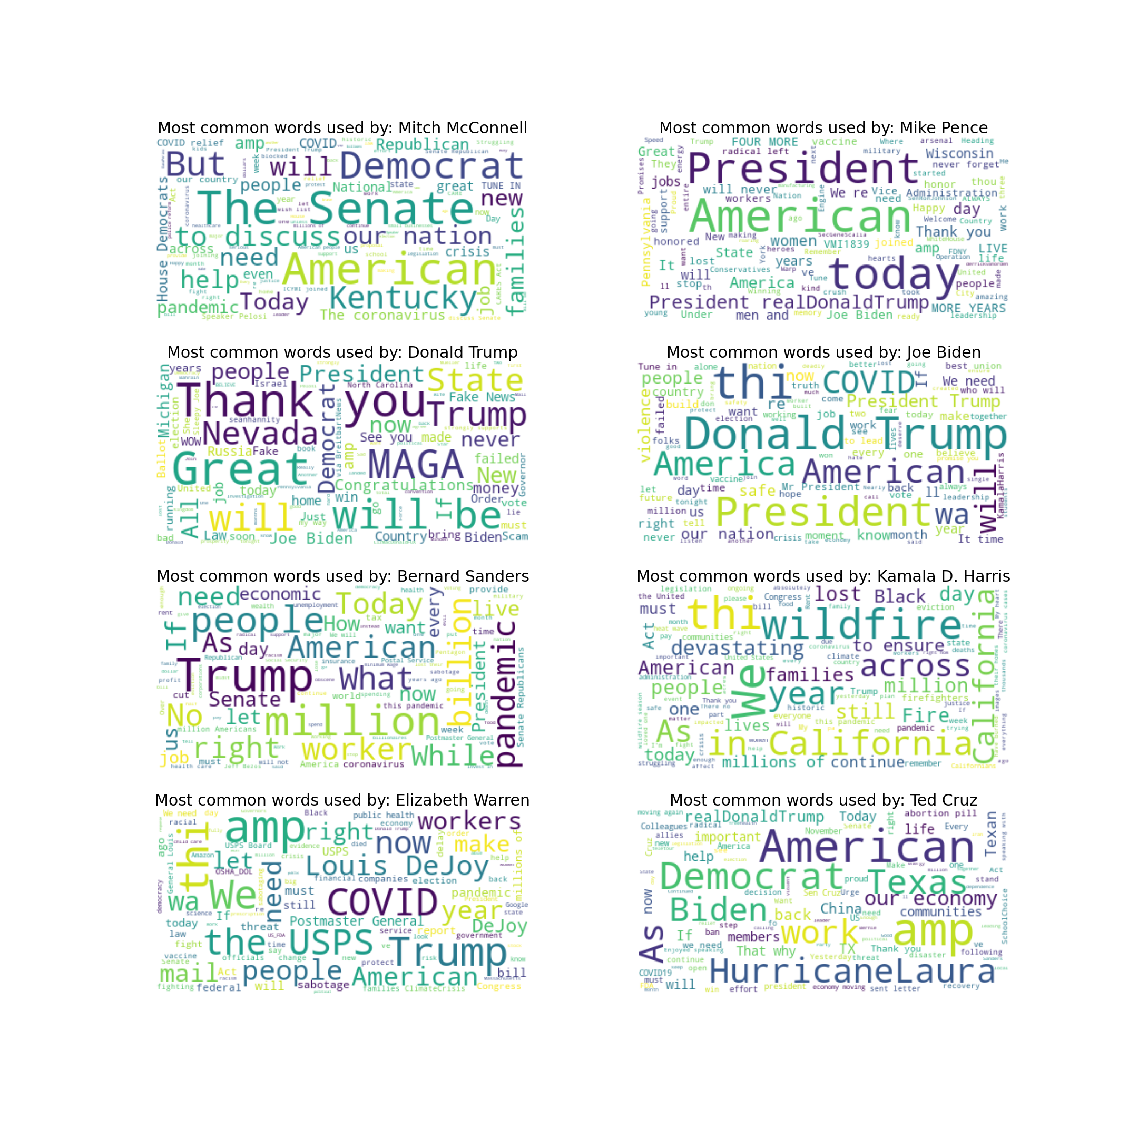
Word Cloud
Takeaway:
Trump is the only one using ‘MAGA’
‘Trump’ is used by Democrats leaders (Probably Criticizing Him)
‘Pandemic’,‘Covid’ were use mostly by the Democrats
‘Billion’, ‘Million’, and ‘Workers’ were used by Bernie Sanders

Slide 17
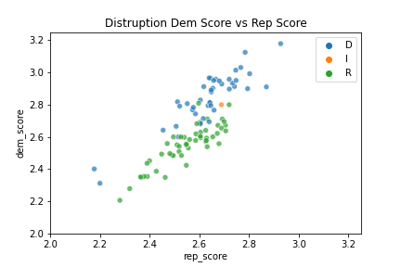
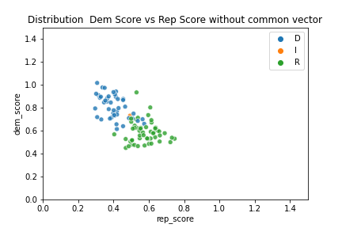
TF-IDF Aggregation Score
Takeaway:
Without using any model, using the sum of TF-IDF Vector, you can clearly see a separation between how parties tweets are distributed

Slide 18
Model Selection

Slide 19
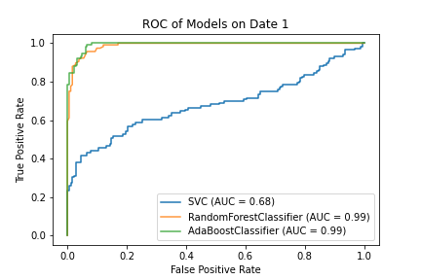
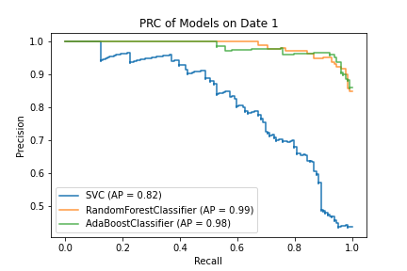
ROC PRC Curve (w common)
Takeaway:
RF Model and AdaBoost Better Perform Equally as well. (Adaboost Model take 30-40x more time to train)

Slide 20
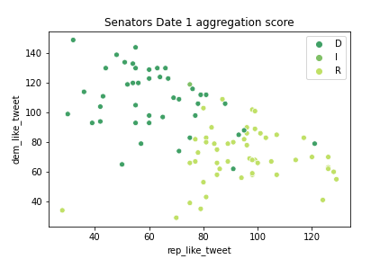
Senator Aggregation Score
Takeaway:
The same pattern found in the TF-IDF analysis is found here as well

Slide 21
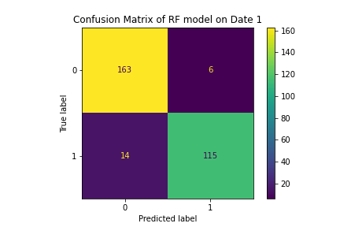
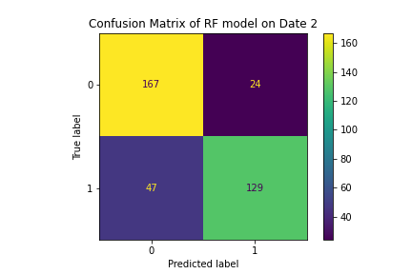
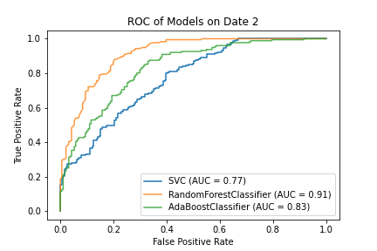
What about another date?
Takeaway: (Date 1 range: 9/5 – 9/12 Date 2 range: 9/15 -9/22)
The accuracy is not as high, but it still works for the most part

Slide 22
Final Take away/Future Research

Slide 23
Final Take away
Identify a politicians affiliation based on their social media accounts?
Yes
Can we quantify where in the political spectrum do they lie?
Yes
Can we quantify intra-party dissonance based on their Tweets?
Yes
Adding common words in your corpus would help you identify party affiliation better than without
Time is a predictive factor, but a difference of 10 days would still work

Slide 24
Future research
Election time vs normal time?
Does this model also apply to the house or representative?
How about local elections?

Slide 25
Extra slide that I won’t use

Slide 26
Motivations
With today political environment, knowing where politicians stand (Or who are you voting for) has been more important than ever.
Instead of having a bias quantitively spectrum that ranks politicians, can we have a measurement that removes the bias and is more data driven? (Not to mention this is probably much quicker)

Slide 27
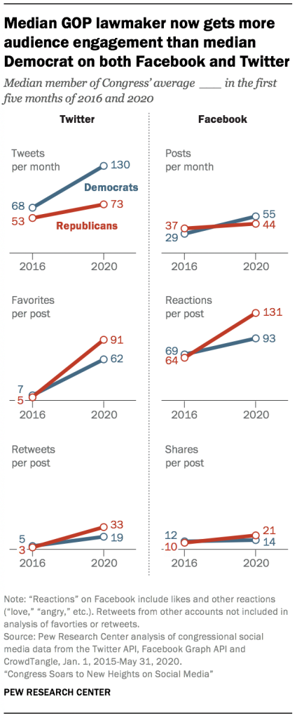
Average Politician social media usage has increase significantly
Social Media is now one of the main communication method for the politicians
Source: https://www.pewresearch.org/internet/2020/07/16/congress-soars-to-new-heights-on-social-media/

